Slide 1


DEPARTMENT OF ARTIFICIAL INTELLIGENCE AND MACHINE LEARNING
SentinelAI
Agentic Threat Intelligence and Automated Response System
Submitted to
Dr. M. Soundarya
Assistant Professor, Department of AI&ML,
Rajalakshmi Engineering College
Presented by
Aniruth S V — 231501015
Girivasanth V — 231501048
Department of AI & ML
Notes:
1

Slide 2
The Problem & Our Solution
The problem
Analysts check suspicious URLs or IPs across several tools, one at a time. This makes triage slow and repetitive, while clues get scattered across reports, screenshots and notes.
Why it matters
Rushed decisions can miss threats; overconfident ones can block legitimate activity.
The SentinelAI approach
Five specialist agents divide the work: they validate the input, gather outside evidence, review the page image, find relevant past knowledge and combine the findings.
The system shows analysts the evidence, a risk score and a plain explanation—then asks for approval before a high-impact action.
Fast investigation, visible evidence, human control.
Department of AI & ML
Notes:
2

Slide 3
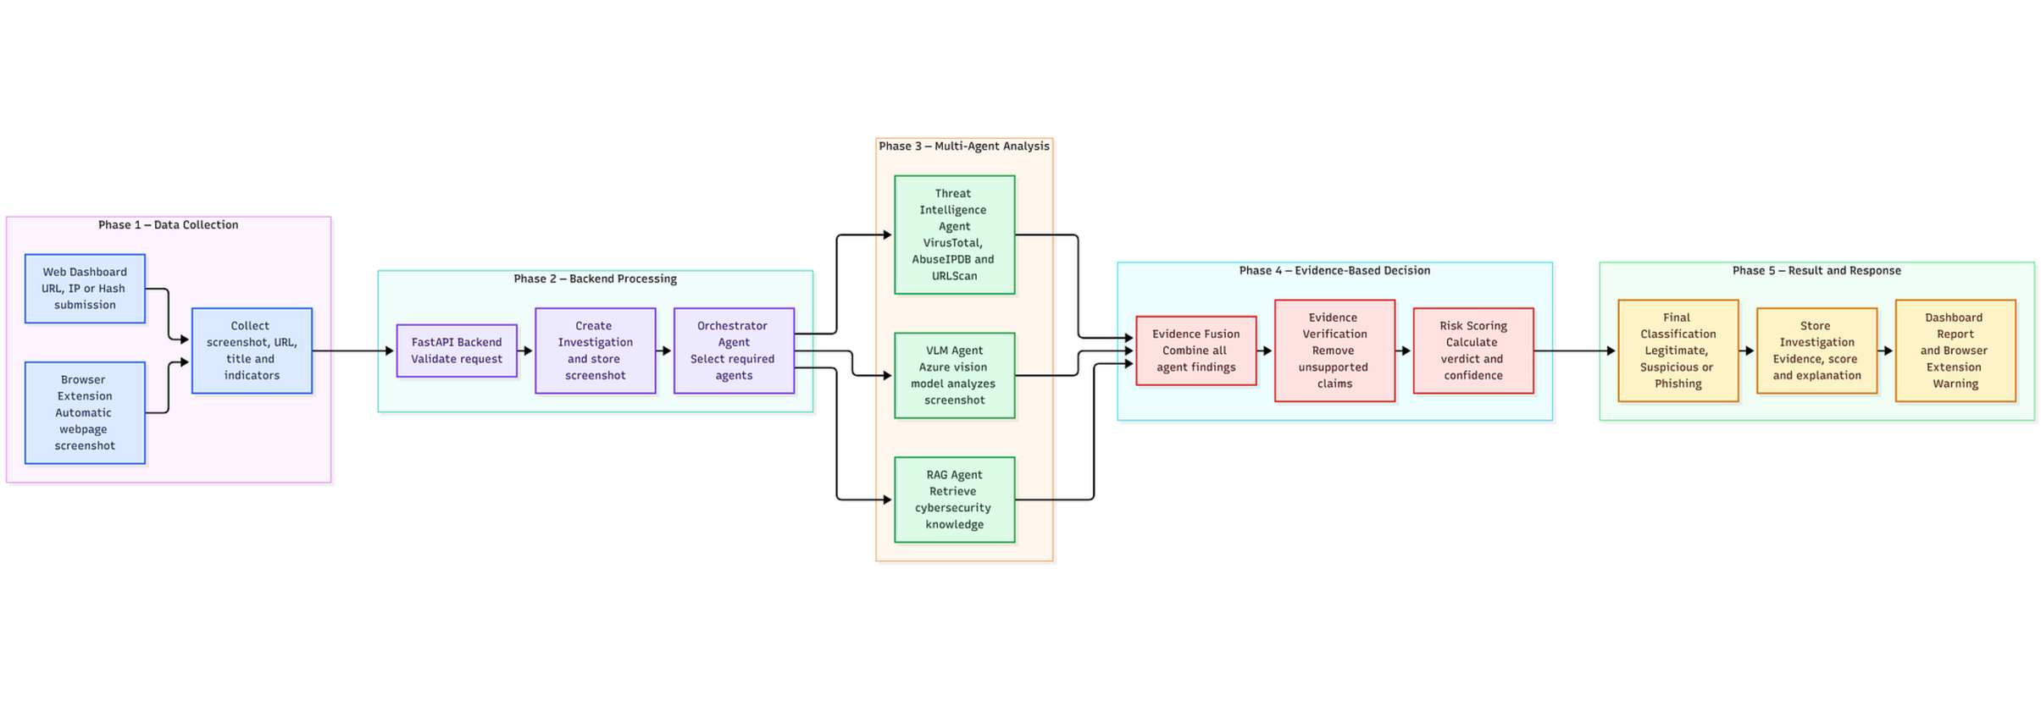
Architecture: Five Agents, One State
Shared InvestigationState keeps inputs, tool results, screenshots, scores and decisions together.
Five focused agents can work on different clues without losing the investigation's history.
Department of AI & ML
Notes:
3

Slide 4
Workflow: From Signal to Safe Action
START
Signal received
Input Validation
Normalize + block unsafe requests
Threat Intelligence
VirusTotal · AbuseIPDB · URLScan
Visual Analysis
VLM reviews a screenshot
RAG Retrieval
Finds relevant guidance in a curated knowledge base; Azure AI Search is optional.
Orchestrator
Combines evidence into a weighted score, verdict and explanation.
END
Reviewable result
Shared InvestigationState
One record carries the original input, normalized value, tool findings, screenshot notes, retrieved context, score, confidence, verdict and approval status.
Department of AI & ML
Notes:
4

Slide 5
Tech Stack
How the system is coordinated
LangGraph acts like a map for the investigation: it routes work between agents and keeps their shared record up to date.
Python runs the service layer. Specialist language-model agents handle focused tasks, while a vision-language model reads screenshots in the way a person would inspect a page.
Retrieval adds relevant past guidance instead of asking the model to guess.
How evidence is gathered safely
VirusTotal, AbuseIPDB and URLScan provide outside reputation signals. Screenshot capture adds visual clues.
Input checks include SSRF protection—rules that stop a request from reaching unsafe internal destinations.
A structured InvestigationState preserves the evidence and decision trail for review.
Specialist agents, controlled tools and decisions that can be explained.
Department of AI & ML
Notes:
5

Slide 6
What Makes SentinelAI Unique
More than one clue
It combines tool results with what the page actually looks like.
Safety before speed
Every fetch is checked so investigation does not create a new risk.
A reason, not a guess
The score, confidence and supporting evidence are shown together.
Agentic means the system can choose the next useful step: one agent gathers reputation data, another reviews the screenshot, another finds relevant guidance, and the coordinator brings the pieces together.
When the result is uncertain or the action is consequential, a person remains in the loop.
Department of AI & ML
Notes:
6

Slide 7
Impact of the Solution
A shorter path to triage
Several evidence-gathering tasks can run together instead of waiting on one tool after another.
A fuller analyst view
The analyst sees reputation results, screenshot observations, retrieved guidance, score, confidence and explanation in one record.
A safer final step
BLOCK decisions, or any confidence below 0.65, require approval before action.
Evidence from the build: 15 tests passed. Phish-IRIS evaluation tracks detection quality, evidence completeness, confidence calibration, latency and approval outcomes.
Department of AI & ML
Notes:
7

Slide 8
Future Scope
What could improve next
Broaden threat-intelligence coverage so analysts have more context.
Add browser and sandbox signals to observe more than a single page view.
Use larger benchmarks to calibrate scores and improve confidence.
How to scale responsibly
Keep policy-controlled containment and approval gates for high-impact actions.
Continue evaluation and red-teaming—deliberately testing how the system fails.
Use analyst feedback to improve the knowledge base, routing and explanations.
Build trust first. Scale autonomy responsibly.
Department of AI & ML
Notes:
8

